Slide 1
Diversity, equity & Inclusion
District 7430 Diversity, Equity & Inclusion Committee
Peter Jones
Title Page Option

Slide 2
purpose
As members in one of the greatest civic organizations in the world, we strive to create an organization that is open and inclusive, fair to all, builds goodwill, and benefits our communities.
A top priority for Rotary is growing and diversifying our membership to make sure we reflect the communities we serve and are inclusive of all cultures, experiences, and identities.
We want people with differing perspectives and ideas who will help Rotary take action to create lasting change in communities around the world.

Slide 3
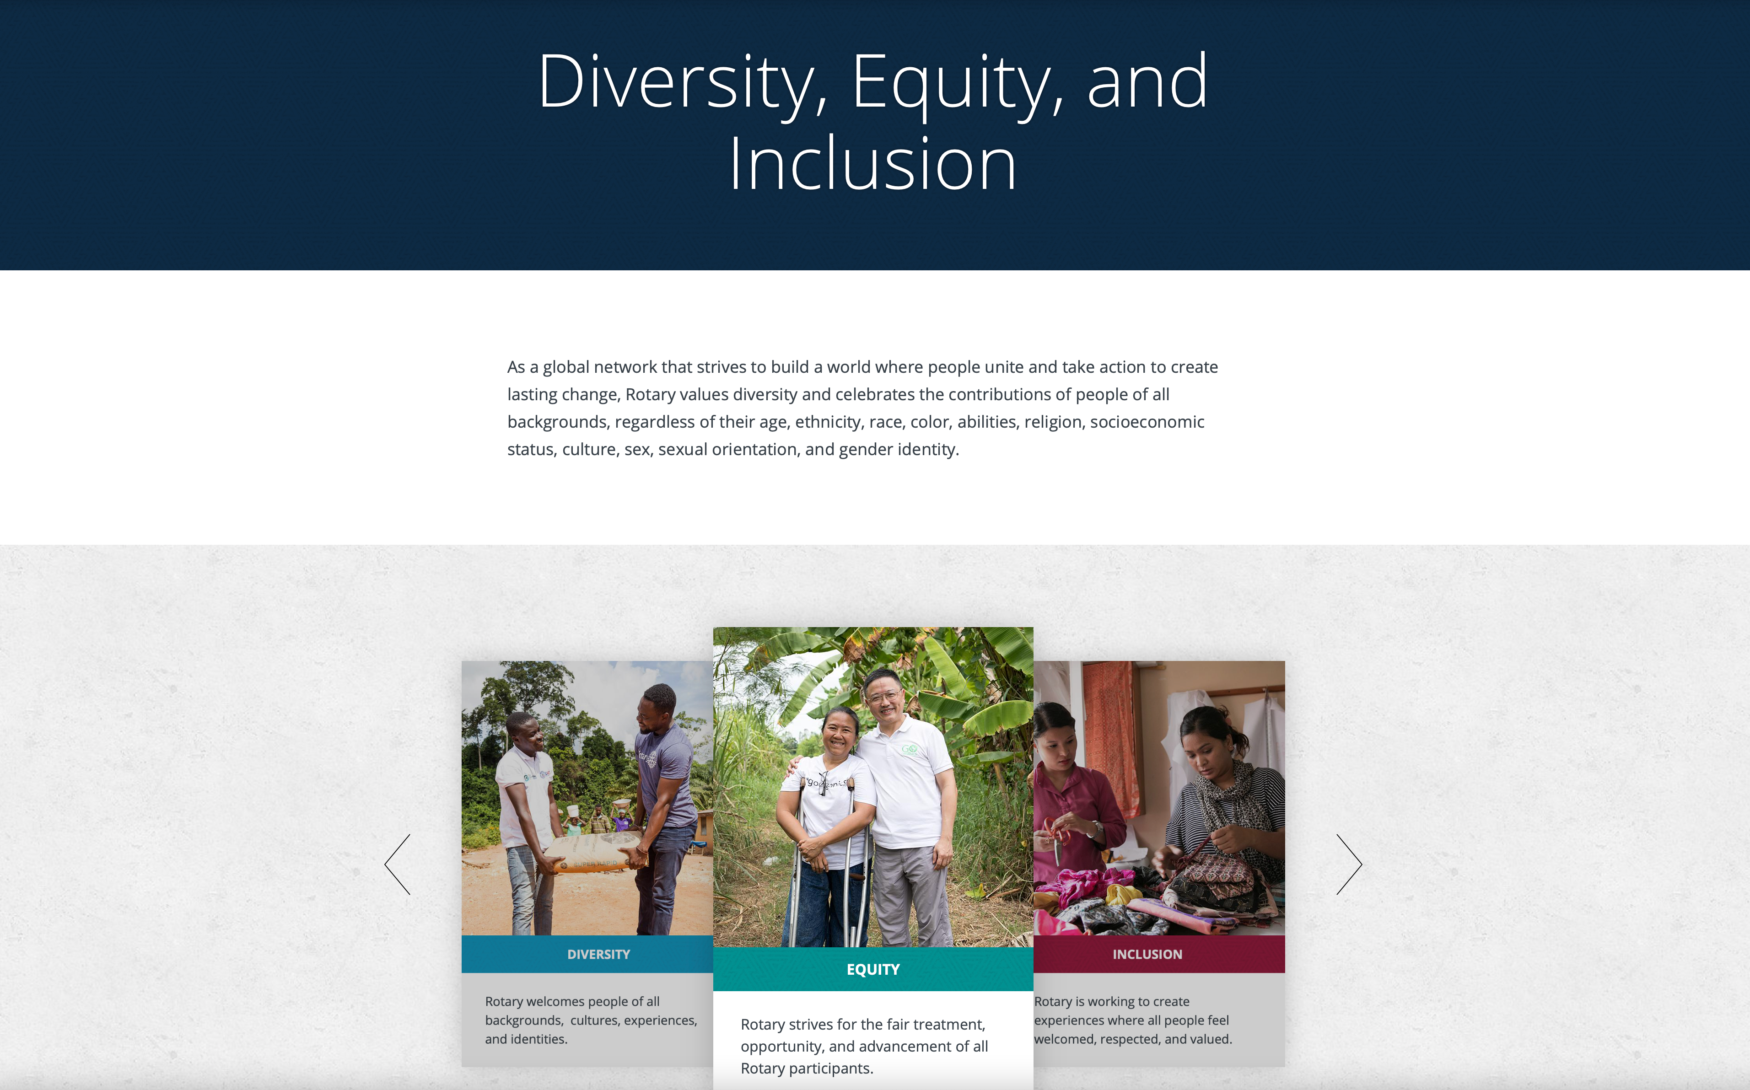

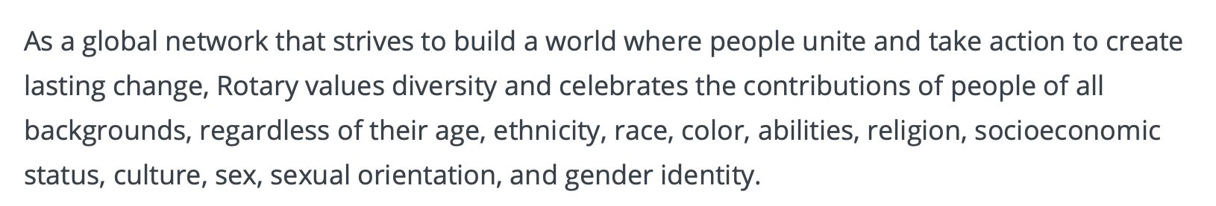
https://www.rotary.org/en/about-rotary/diversity-equity-and-inclusion

Slide 4
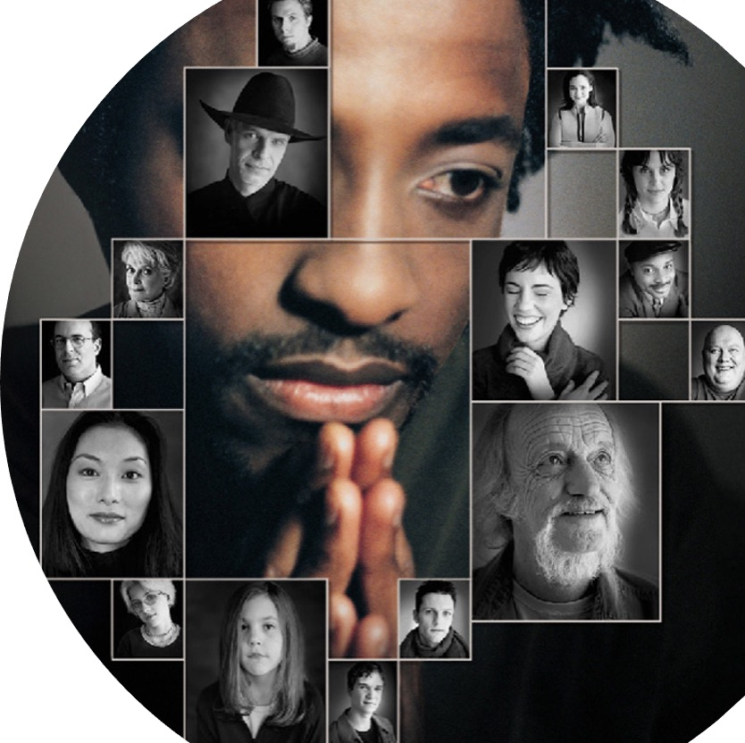

diversity
Diversity is the mosaic of people who bring a variety of backgrounds, styles, perspectives, values and beliefs as assets to the groups and organizations with which they interact.

Slide 5
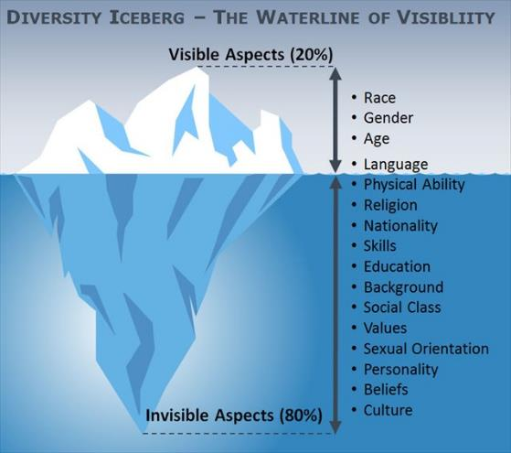
The diversity iceberg

Slide 6

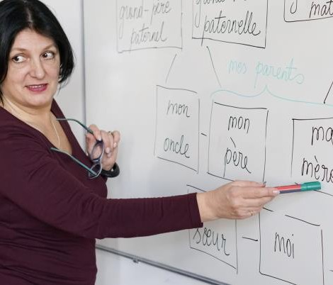
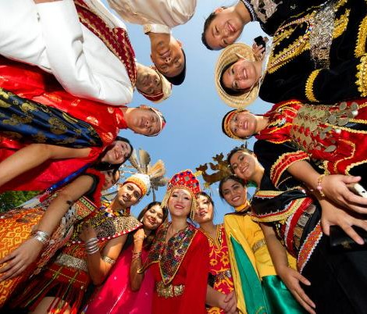


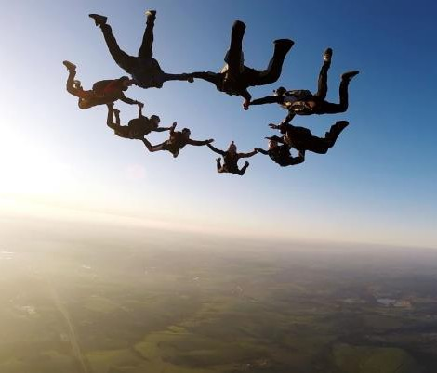
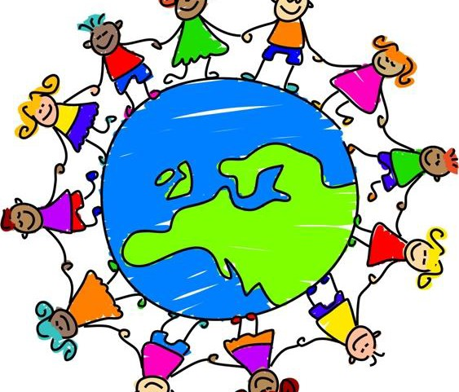

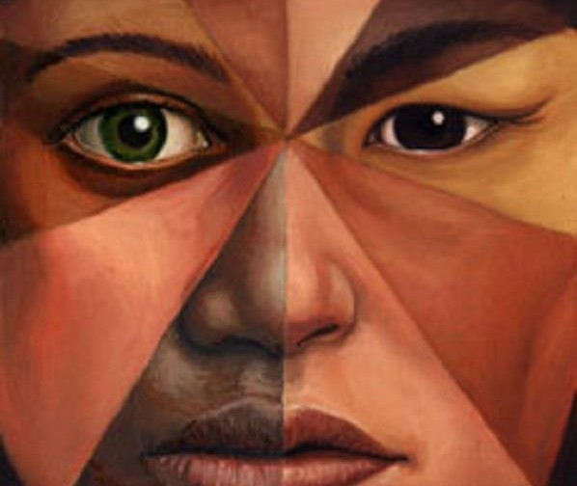
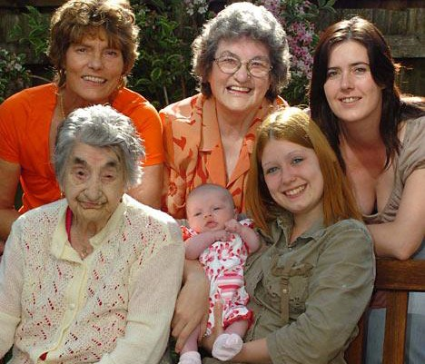

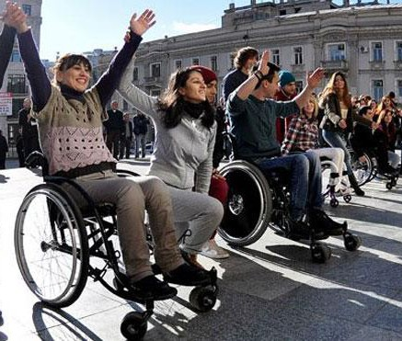


What is Diversity in Rotary?
Thinking Styles
Language
Ethnicity
Religion
Perspectives
Experiences
Nationality
Job Level
Race
Gender
Age
Culture
Physical
Sexual
Skills
Abilities
Orientation

Slide 7
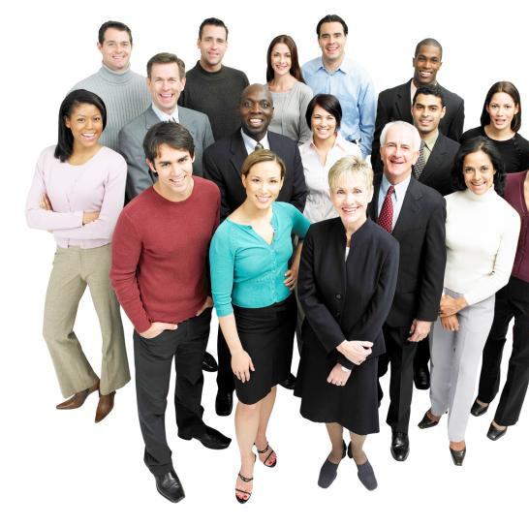
inclusion
Inclusion is the achievement of a club environment in which all individuals are treated fairly and respectfully, have equal access to opportunities and resources, and can contribute fully to the club’s success.

Slide 8
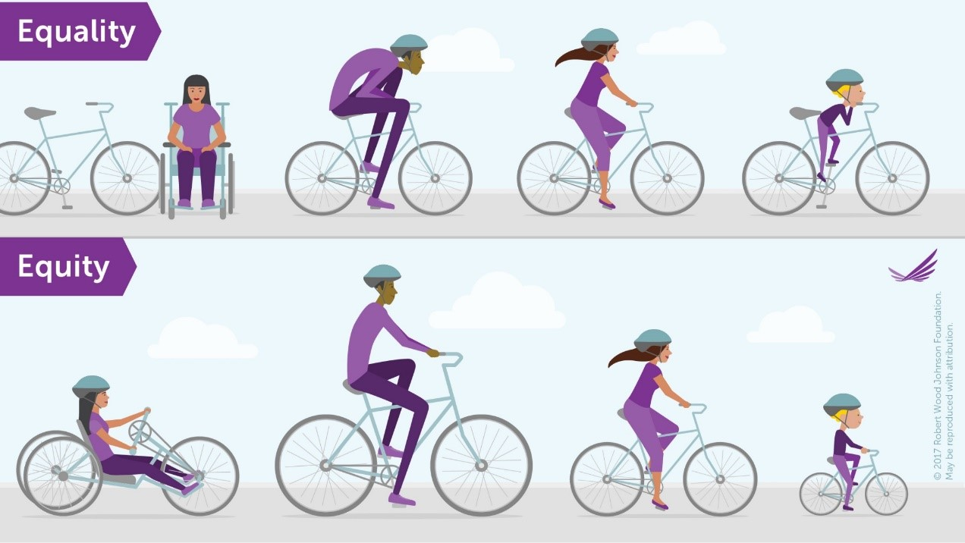
Equality:
The assumption is that everyone benefits from the same support. This is considered to be equal treatment.
Equity:
Everyone gets the unique support they need to be successful.
Equity is the active removal of barriers to promote fair treatment, opportunity, and advancement for all regardless of background.

Slide 9

Belonging
“When we feel a sense of belonging it is not because we are the same as everyone else, but because we have been accepted as we are.”

Slide 10
District 7430 Diversity, Equity& Inclusion Committee
A top priority for Rotary is growing and diversifying our membership to make sure we reflect the communities we serve.
Rotary will cultivate a diverse, equitable, and inclusive culture in which people from underrepresented groups have greater opportunities to participate as members and leaders.
We're creating an organization that is more open and inclusive, fair to all, builds goodwill, and benefits our communities. We want people with differing perspectives and ideas who will help Rotary take action to create lasting change in communities around the world.

Slide 11
Benefits of Diversity, equity & Inclusion in rotary
Helps us consider different points of view.
Provides us with additional skills and knowledge needed to meet our mission.
Provides multiple perspectives on problem solving.
Increases club productivity.
Increased member retention rates.
Boosts club morale.
It’s the right thing to do!

Slide 12
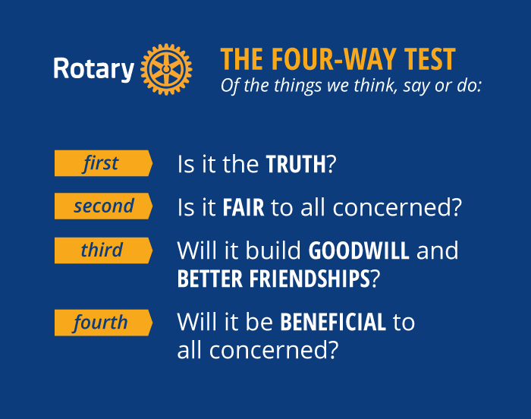
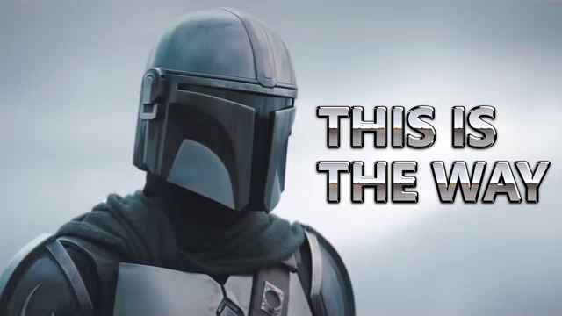
The four-way test

Slide 13
Diversity, equity & inclusion enablers
Recognizing the differences that make each of us unique.
Attracting people of all backgrounds together in a respectful environment.
Creating an environment where everyone is appreciated and has a chance to succeed.
Recognizing how attitudes toward differences influence our interactions with others.

Slide 14
Diversity, equity & inclusion barriers
Fear of change is counterproductive, especially fear of ideas and people who are different from us.
Bias occurs when you make spontaneous judgments about people or situations based on your past experiences, culture, background, or exposure to media.
“I think we have to own the fears that we have of each other, and then, in some practical way, some daily way, figure out how to see people differently than the way we were brought up to.”
Alice Walker
““Just as a child is born without fear,
so it is born without prejudice.
Prejudice, like fear, is acquired.”
Marie Killea

Slide 15

questions for reflection and action
What has been my Rotary Club’s experience with diversity, equity & inclusion?
What do I need to know about the diverse makeup of our community?
What more do we need to learn about to overcome our DEI challenges?
What actions can our club take to expand the reach of Rotary and be more inclusive?

Slide 16
How Can rotary members
Promote Diversity, equity & inclusion?
Practice
Practice positive, constructive conversations; work cooperatively towards a common goal.
Contribute
Live up to the social contract; contribute to your fullest potential; strive for excellence.
Recognize and Respect
Recognize and respect others and their individuality.
Think Before Speaking
Think before you speak and be sensitive to others.
Engage Others
Talk about your differences and ask tactful questions about how people want to be treated.
Eliminate Bias
Eliminate stereotypes and generalizations.

Slide 17
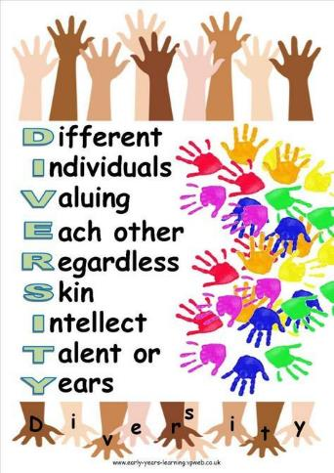
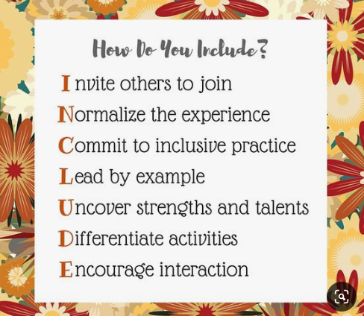
summary

